Slide 1

Bike Renting Demand Prediction
Presented by:
Shivraj Patil
Linkedin : https://www.linkedin.com/in/shivraj-patil-b6a9091b6/
GitHub : https://github.com/shivrajp-11

Slide 2

Shivraj G Patil
Aspiring Data Scientist
Education
Skills
Contact
B.Tech Automobile Engineering (2017-2021) from Symbiosis Skills and Professional University, Pune
HSC Science(2017), Jaihind Jr College of Science
SSC(2015) , Canossa Convent High School
ShivTrupti, Babulwadi Road, Fagane.Tal Dist Dhule
Python
Statistics
SQL
+91-8412840909
Pandas
Excel
shivrajgpatil99@gmail.com
Work Experience
Safety Engineer Tata Motors Passenger Vehicle Ltd, Pune (2021-22)
Hobbies
Languages
Data Analysis of Industrial injuries for further incident prevention
Safety Audits to improve the workplace environment
English
Intern Road Safety (2020-21)
Video
Music
Travelling
Fixed Gear
Marathi
1. Root cause analysis for Road Accidents
Hindi

Slide 3
Problem Statement:
Currently Rental bikes are introduced in many urban cities for the enhancement of mobility comfort. The client is Seoul Bike, which participates in a bike share program in Seoul, South Korea. An accurate prediction of bike count is critical to the success of the Seoul bike share program.
It is important to make the rental bike available and accessible to the public at the right time as it lessens the waiting time. Eventually, providing the city with a stable supply of rental bikes becomes a major concern.
The final aim of this project is the prediction of bike count required at each hour for the stable supply of rental bikes.

Slide 4
Work Flow:
Data Collection
and
Understanding
Data Wrangling & Feature Engineering
02
Conclusions
EDA
Model Selection and Evaluation
Preparation of data for model building.
05

Slide 5
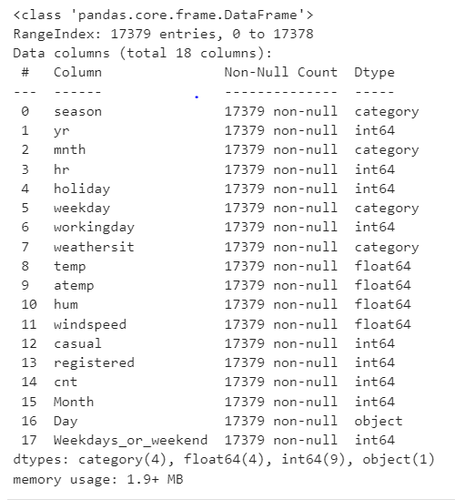
Data Features:
Bike Data is used for Analysis and Model Building
The dataset contains weather information (Temperature, Humidity, Wind speed), the number of bikes rented per hour and date information.
In this we had total 8760 observations and 14 features including target variable.

Slide 6
Data Wrangling and Feature Engineering:
As we know we had 8760 observations and 14 features.
Categorical Features: Seasons, Holiday and Functioning day.
Numerical Columns: Date, Hour, Temperature, Humidity, Wind speed, Rented Bike count .
The Dataset has no null values.
Zero Duplicate entries found.
We changed the data type of Date column from ‘object’ to ‘datetime64[ns]’. This was done for feature engineering.
We Created two new columns with the help of Date column ‘Month’ and ‘Day’. Which were further used for EDA. And later we dropped Date column.

Slide 7
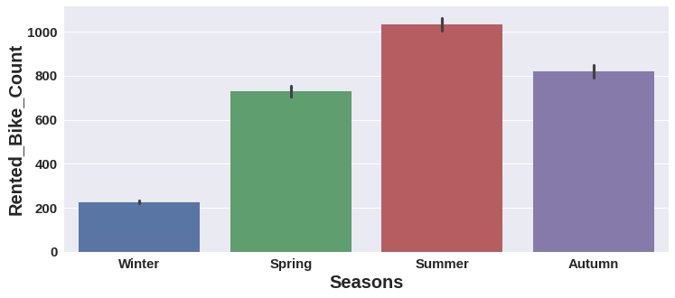
EDA (Exploratory Data Analysis)
-
Summer season had the highest Bike Rent Count

Slide 8
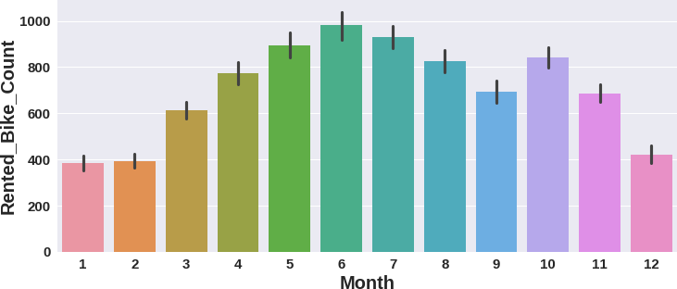
EDA (Exploratory Data Analysis)
Bike Rent Count started since March and it was highest in June.

Slide 9
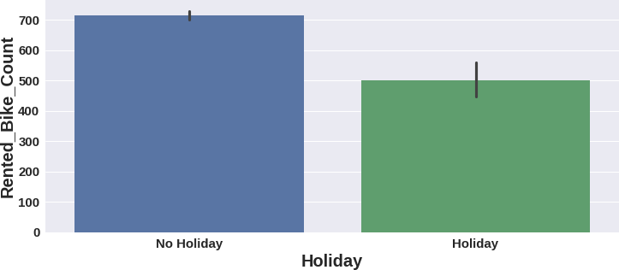
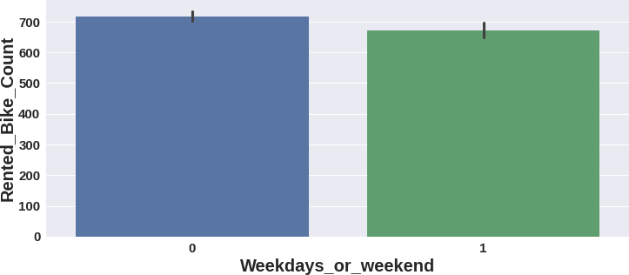
EDA (Exploratory Data Analysis)
High number of bikes were rented on No Holidays.
Which is almost 700 bikes.
More than 700 bikes were rented on weekdays.
On weekdays, almost 650 bikes were rented.

Slide 10
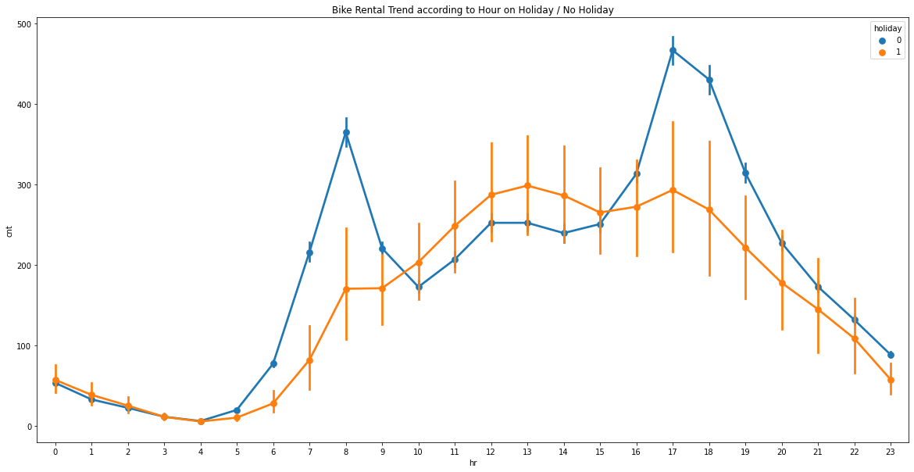
EDA (Exploratory Data Analysis) : Observation

Slide 11
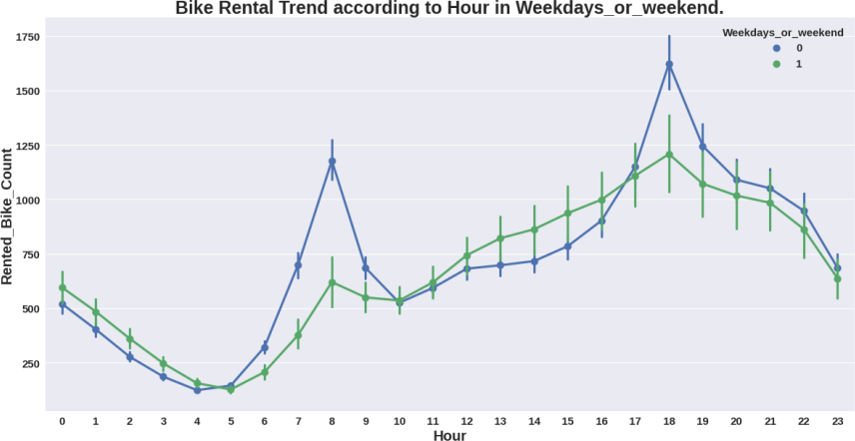
EDA (Exploratory Data Analysis) : Observation

Slide 12
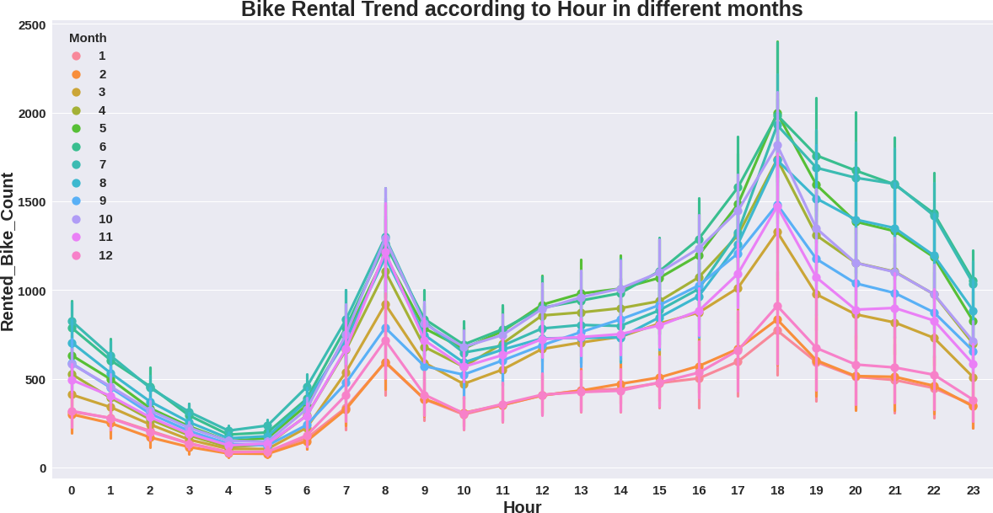
EDA (Exploratory Data Analysis) : Observation

Slide 13
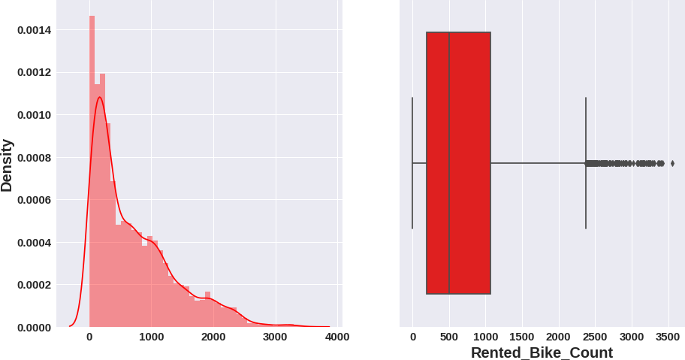
EDA (Exploratory Data Analysis) : Observation

Slide 14
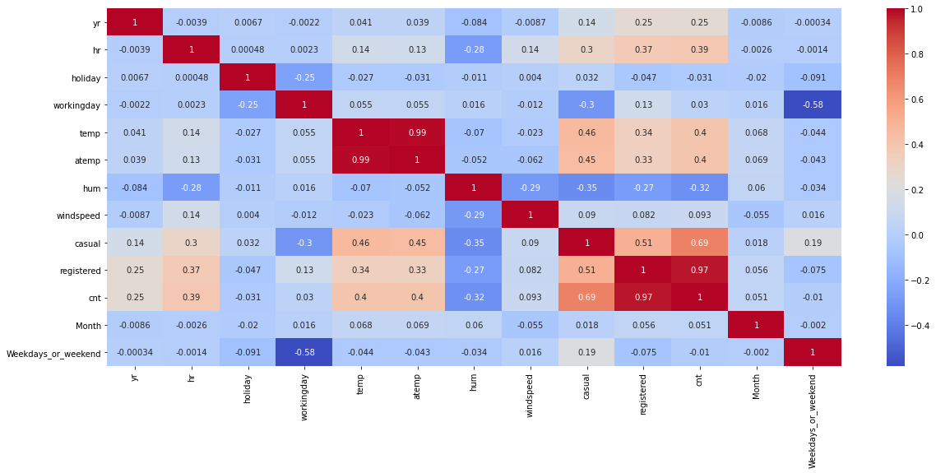
Preparation of Data for Model Building
Next we created dummy variables for categorical Seasons column and did mapping with 0 and 1 for holiday and functioning column.

Slide 15
Model Selection and Evaluation
As this is the regression problem we are trying to predict continuous value. For this we used following regression
models.
Linear Regression
Lasso regression (regularized regression)
Ridge Regression(regularized regression)
ElasticNet Regression(regularized regression)
Decision Tree Regression.
Random forest Regression
Gradient Boosting Regression
Xtream Gradient Boosting Regression.

Slide 16
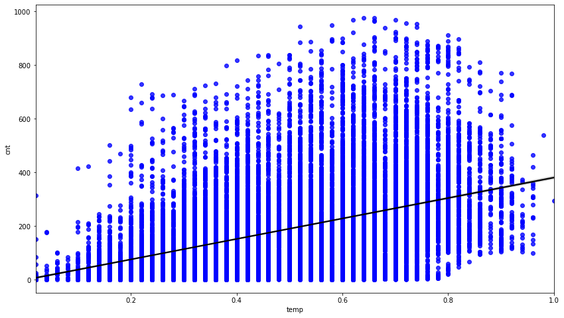
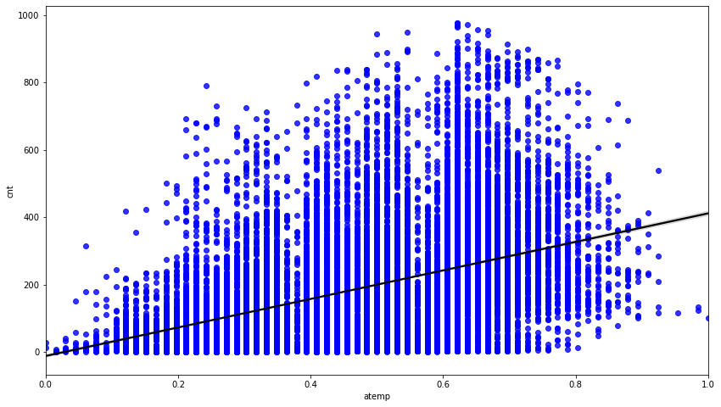
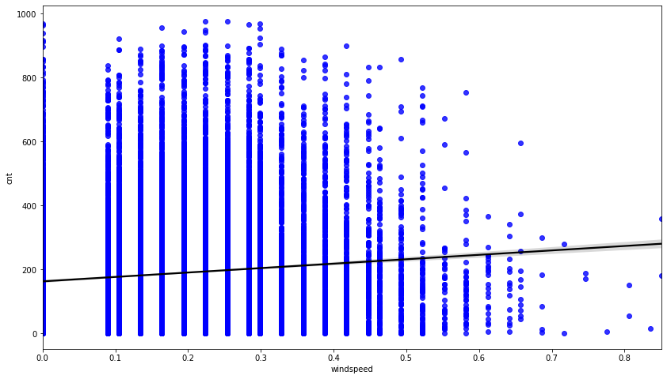
Model Selection and Evaluation
From the above regression plot of all numerical features we see that the columns ‘temp', 'Windspeed’, ‘atemp' are positively relation to the target variable,which means the rented bike count increases with increase of these features.

Slide 17
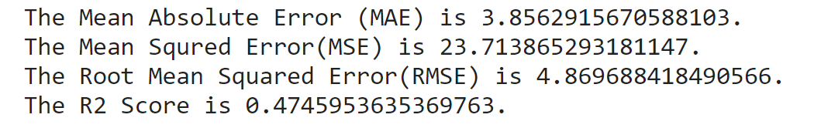
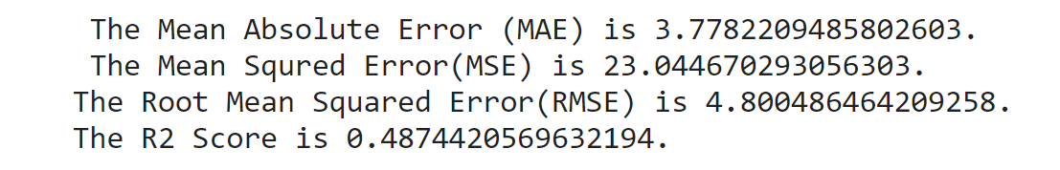
Model Selection and Evaluation
Linear Regression:
Train Set:
Test Set:-
Linear regression analysis is used to predict the value of a variable based on the value of another variable.

Slide 18
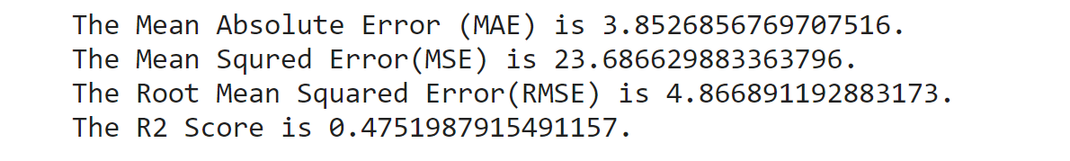
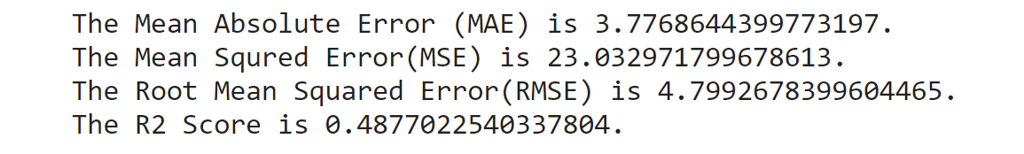
Model Selection and Evaluation
Ridge Regression:
Train Set:
Test Set:-
Ridge regression is a model tuning method that is used to analyse any data that suffers from multicollinearity.

Slide 19
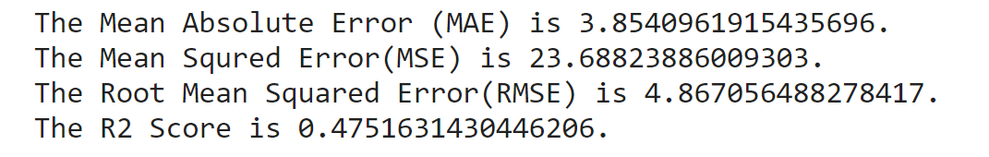
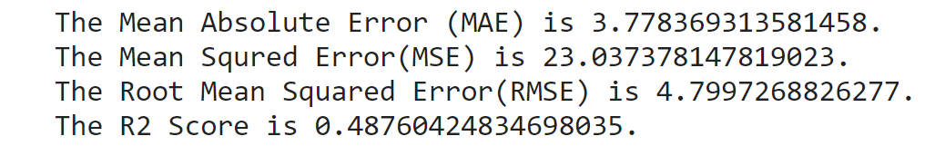
Model Selection and Evaluation
ElasticNet Regression:
Train Set:
Test Set:-
Elastic net linear regression uses the penalties from both the lasso and ridge techniques to regularize regression models.

Slide 20
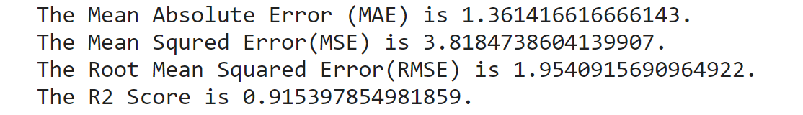
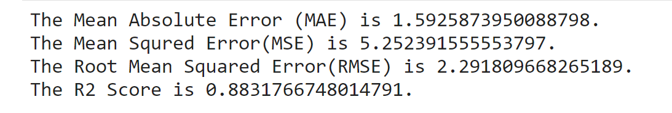
Model Selection and Evaluation
Decision Tree Regression:
Train Set:
Test Set:-
Decision tree regression observes features of an object and trains a model in the structure of a tree to predict data in the future to produce meaningful continuous output.

Slide 21
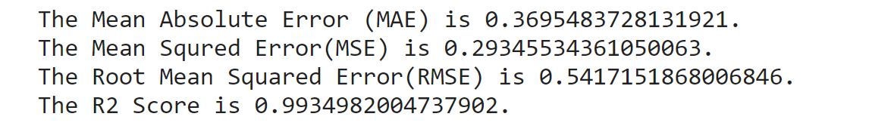
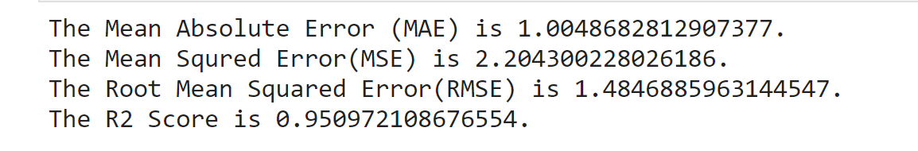
Model Selection and Evaluation
Random Forest Tree Regression:
Train Set:
Test Set:-
Random forest is a type of supervised learning algorithm that uses ensemble methods (bagging) to solve both regression and classification problems.

Slide 22
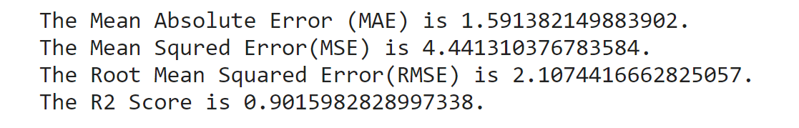
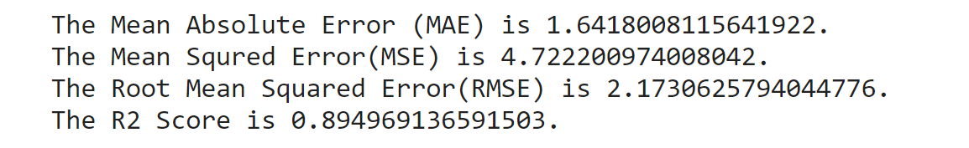
Model Selection and Evaluation
Gradient Boosting Regression:
Train Set:
Test Set:-
Similar to finding the line of best fit in linear regression, the goal of gradient descent is to minimize the cost function, or the error between predicted and actual y.

Slide 23
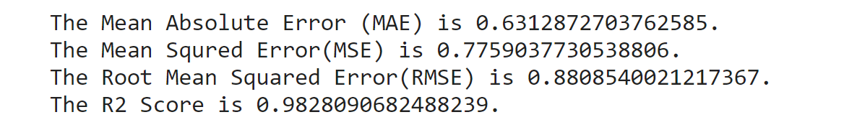
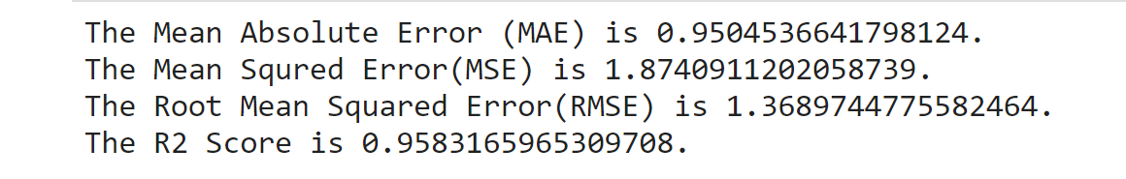
Model Selection and Evaluation
Xtream-Gradient-Boosting Regression:
Train Set:
Test Set:-
Extreme Gradient Boosting is a tree-based algorithm, which sits under the supervised branch of Machine Learning.

Slide 24
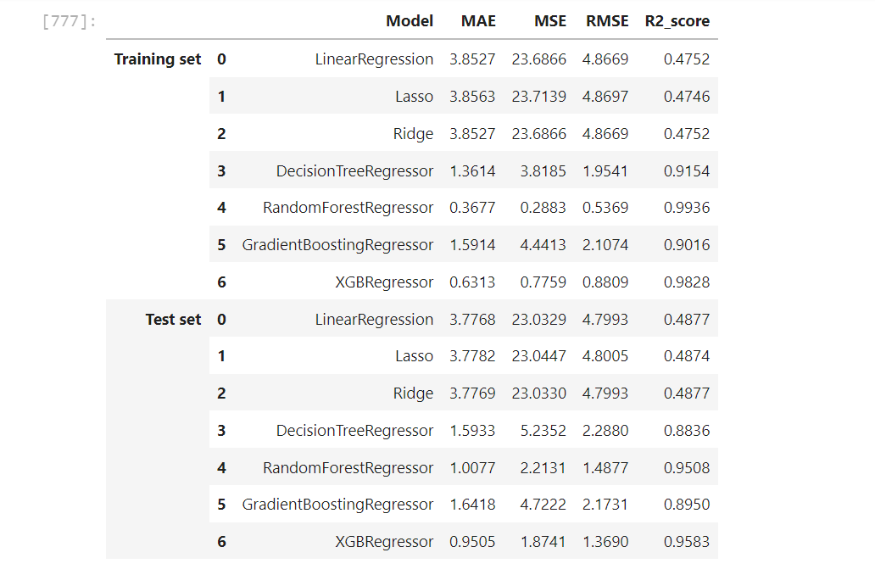
Conclusion:

Slide 25
Thank-You

